Slide 2

Financial Analysis & Modelling
Cost & Management Accounting - II
Best wishes
Dr R Narayanaswamy

Slide 3
Decisions
Make or Buy
Limiting factor
Level of activity
Determination of sales mix
Exploring new markets
Discontinuance of a product line
Salary or Commission
………………and many more
+ 91 98452 87646 Dr R. Narayanaswamy lecswamy@gmail.com
Notes:
www.swamyspfa.in

Slide 4
Limiting factor
Limiting factor or key factor is the factor that governs the entire course of operations for the business.
Decision regarding production should be based on contribution per limiting factor and not on general contribution of the product
Limiting factor can be availability of machine time, labour, materials, markets, unique requirements, etc.
Every business has its own constraints and limitations, which will act as limiting factor.
No business can escape this.
+ 91 98452 87646 Dr R. Narayanaswamy lecswamy@gmail.com
Notes:
www.swamyspfa.in

Slide 5
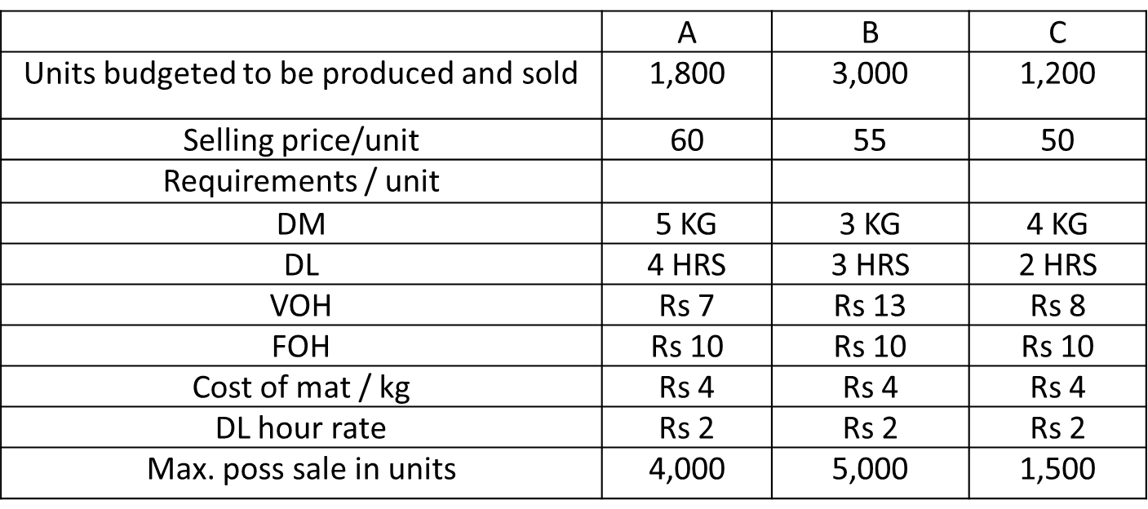
Limiting factor
Find the most profitable mix and prepare a statement of profitability from the following data.
All the three products are produced from the same direct material using the same type of machines and labor which is limited to 18,600 hours.
+ 91 98452 87646 Dr R. Narayanaswamy lecswamy@gmail.com
Notes:
www.swamyspfa.in

Slide 6
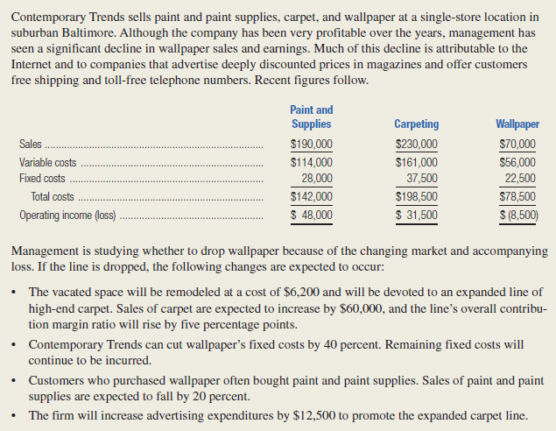
Decision Making - Discontinuance
+ 91 98452 87646 Dr R. Narayanaswamy lecswamy@gmail.com
Notes:
www.swamyspfa.in

Slide 7
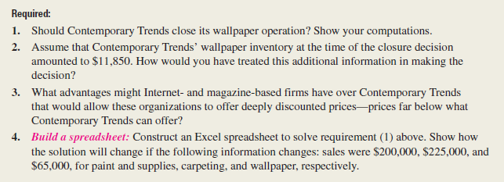
Decision Making - Discontinuance
+ 91 98452 87646 Dr R. Narayanaswamy lecswamy@gmail.com
Notes:
www.swamyspfa.in

Slide 8
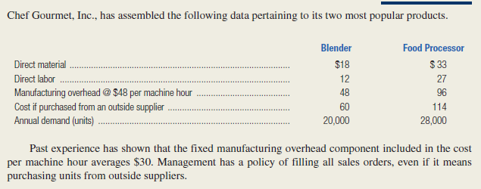
Decision Making – Production decision
+ 91 98452 87646 Dr R. Narayanaswamy lecswamy@gmail.com
Notes:
www.swamyspfa.in

Slide 9
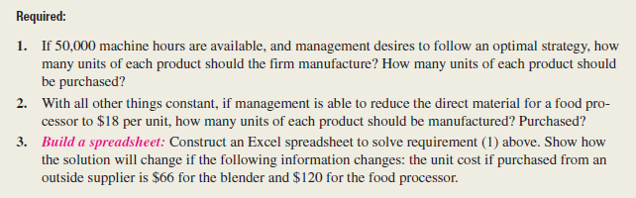
Decision Making – Production Decision
+ 91 98452 87646 Dr R. Narayanaswamy lecswamy@gmail.com
Notes:
www.swamyspfa.in

Slide 10
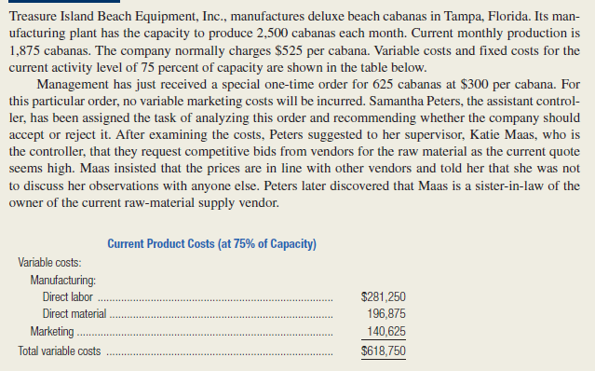
Decision Making – Special Order
+ 91 98452 87646 Dr R. Narayanaswamy lecswamy@gmail.com
Notes:
www.swamyspfa.in

Slide 11
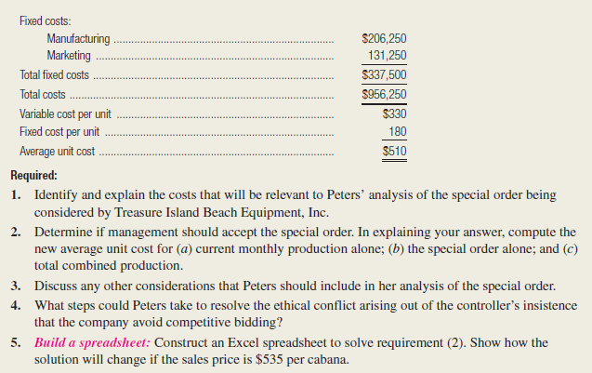
Decision Making – Special Order
+ 91 98452 87646 Dr R. Narayanaswamy lecswamy@gmail.com
Notes:
www.swamyspfa.in

Slide 12
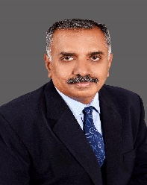
Happy Learning
Best wishes
+ 91 98452 87646 Dr R. Narayanaswamy lecswamy@gmail.com
Notes:
www.swamyspfa.blogspot.in

